Slide 1
Listing factors
Properties of number: factors, multiples, squares and cubes

Slide 2
how to use Oak lessons

Slide 3
I can state what a factor is and can identify factors of positive integers.

Slide 4
A numerical factor is a factor that is an integer.
A product is the result of two or more numbers multiplied together.
Divisibility is a number’s ability to be exactly divided by another number, leaving no remainder.

Slide 5

Listing factors
Systematic approach to find factor pairs
Common factors
Simplify fractions using common factors

Slide 6

Systematic approach to find factor pairs
Lucas has 12 counters.
He decides to make as many arrays as he can.
How many unique arrays can he make?
Has Lucas made 4 unique arrays?
No, the last 2 are the same array.

Slide 7
Systematic approach to find factor pairs
By drawing the arrays Lucas has found the factor pairs.
Imagine we wanted to find the factor pairs of 1000.
Would it be sensible to draw arrays to find them?
We can visualise the arrays and systematically list them.
Let’s have a go with 54
1
1 × 54
2
2 × 27
REMEMBER
factor × factor = product
We have found all the factor pairs of 54.
3
3 × 18
6
6 × 9

Slide 8
Systematic approach to find factor pairs
List all the factor pairs of 80
List all the factors pairs of 200
1 × 80
1
1 × 200
2 × 100
4 × 50
5 × 40
8 × 25
10 × 20
2 × 40
2
4 × 20
4
5 × 16
5
8 × 10
8
9 is not a factor as the sum of the digits is not 9
The next factor would be 10 but we already have 10 in a factor pair.

Slide 9

Systematic approach to find factor pairs
Laura is finding the factor pairs of 60.
Has Laura found them all?
6 × 10
2 × 30
4 × 15
12 × 5
3 × 20
No, Laura missed out 1 × 60.
What could Laura have done to make it easier to ensure she had all of the factor pairs?
She could have listed them systematically.

Slide 10
Systematic approach to find factor pairs
List the factor pairs of these numbers.
18
b) 28
c) 36
d) 32
e) 100
f) 67

Slide 11
Systematic approach to find factor pairs
2) Sam makes two rectangles with an area of 10 cm².
Explain how these rectangles show all of the factors of 10.

Slide 12
Systematic approach to find factor pairs
List the factor pairs of these numbers.
18
b) 28
c) 36
d) 32
e) 100
f) 67
1 × 18
2 × 9
3 × 6
1 × 28
2 × 14
4 × 7
1 × 36
2 × 18
3 × 12
4 × 9
6 × 6
1 × 32
2 × 16
4 × 8
1 × 100
2 × 50
4 × 25
5 × 20
1 × 67

Slide 13
Systematic approach to find factor pairs
2) Sam makes two rectangles with an area of 10 cm².
Explain how these rectangles show all of the factors of 10.
Because you cannot make a rectangle with a height of 3, 4, 6, 7, 8, or 9.
So 1 & 10 and 2 & 5 are the only factor pairs.

Slide 14
Listing factors
Systematic approach to find factor pairs
Common factors
Simplify fractions

Slide 15



Common factors
I’ve found all of the factor pairs of 20.
I’ve found all of the factor pairs of 30.
Can you think of any factors that both Jun & Izzy have written?
1 × 20
2 × 10
4 × 5
1 × 30
2 × 15
3 × 10
5 × 6
They both have 1, 2, 10 & 5.
This means that 1, 2, 5 and 10 are the common factors of 20 and 30.

Slide 16

Common factors
There are no numbers that are a common factor of all integers.
You cannot make an array of height 2 for odd numbers.
You can always make an array of height or width of 1.

Slide 17
Common factors
We can put factors into a Venn diagram to help us identify the common factors.
Factors of 36
4
1
Factors of 54
3
27
12
2
18
54
36
6
9
The factors of 36 are: 1, 2, 3, 4, 6, 9, 12, 18, and 36
The factors of 54 are: 1, 2, 3, 6, 9, 18, 27 and 54
There is one factor missing in this Venn diagram.
Which one is missing?
Where should it go?
18 missing
It is a common factor so will go in the intersection.

Slide 18
Common factors
Find all the common factors of 248 and 300.
Factor pairs of 248
Factor pairs of 300
1 × 248
2 × 124
4 × 62
1 × 300
2 × 150
3 × 100
4 × 75
Are these all the factors of each integer?
No, for large integers it’s difficult to list them all.
Write down a pair which has been left out for each.
E.g. 8 × 31 for 248 and 30 × 10 for 300

Slide 19

Common factors
Which of the following is not a common factor of 80 and 56?
Factors of 80
80
14
Factors of 56
16
1
2
28
40
4
7
20
8
56
10
a
b
c
4
7
8

Slide 20
Common factors
Use the Venn diagram to fill in the gaps.
45 has factors which are not common with 60.
60 has factors which are not common with 45.
45 and 60 have common factors.
The common factors of 45 and 60 are .
4
Factors of 45
9
60
Factors of 60
1
3
30
45
5
15
20
2
12

Slide 21
Common factors
2) Find the common factors for each of these following pairs of numbers:
a) 24 & 36
b) 24 & 38
c) 24 & 40
d) 24 & 48

Slide 22
Common factors
Use the Venn diagram to fill in the gaps.
45 has 2 factors which are not common with 60.
60 has 6 factors which are not common with 45.
45 and 60 have 4 common factors.
The common factors of 45 and 60 are 1, 3, 5 and 15.
4
Factors of 45
9
60
Factors of 60
1
3
30
45
5
15
20
2
12

Slide 23
Common factors
2) Find the common factors for each of these following pairs of numbers:
a) 24 & 36
b) 24 & 38
c) 24 & 40
d) 24 & 72
1 × 24
2 × 12
3 × 8
4 × 6
1 × 36
2 × 18
3 × 12
4 × 9
6 × 6
1 × 24
2 × 12
3 × 8
4 × 6
1 × 38
2 × 19
1 × 24
2 × 12
3 × 8
4 × 6
1 × 40
2 × 20
4 × 10
5 × 8
1 × 24
2 × 12
3 × 8
4 × 6
1 × 72
2 × 36
3 × 24
4 × 18
6 × 12
8 × 9

Slide 24
Listing factors
Systematic approach to find factor pairs
Common factors
Simplify fractions

Slide 25


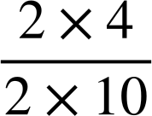
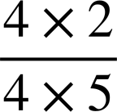



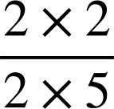
Simplifying fractions
Aisha and Sam are simplifying fractions.
They both simplify to its lowest terms using factor pairs.
=
=
=
=
=
Whose method is more efficient?
Aisha’s is more efficient.
Sam
What makes their method more efficient?
Because they have done it in one step. They have used the highest common factor of 8 and 20.
Aisha

Slide 26


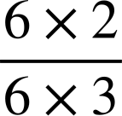

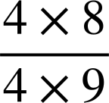

Simplifying fractions
Simplify using the highest common factor
Factors of 12: 1, 2, 3, 4, 6 & 12
Factors of 18: 1, 2, 3, 6, 9 & 18
Simplify using the highest common factor
Factors of 32: 1, 2, 4, 8, 16 and 32
Factors of 36: 1, 2, 3, 4, 6, 9, 12, 18 and 36
=
=
=
=

Slide 27




Simplifying fractions
Which of the following is simplified to its lowest form?

Slide 28










Simplifying fractions
Simplify fully the following fractions.
Try to use the highest common factor.
a)
b)
c)
d)
e)
2) a) Which of the following are not in their simplest form?
b) Simplify those you have identified.

Slide 29
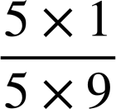

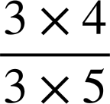

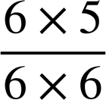

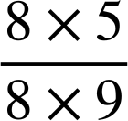

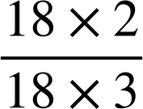

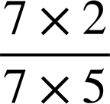
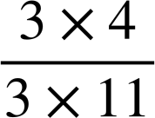
Simplifying fractions
Simplify fully the following fractions.
Try to use the highest common factor.
a)
b)
c)
d)
e)
=
=
=
=
=
2) a) Which of the following are not in their simplest form?
b) Simplify those you have identified.
=
=

Slide 30
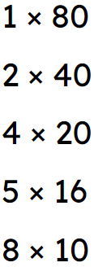

Listing factors
Factors can be listed in a systematic way. E.g.
Common factors of integers can be found by listing factor pairs.
Fractions can be simplified using the highest common factor. E.g.

Slide 31

© Oak National Academy 2023.
Produced in partnership with Mathematics in Education and Industry.
Licensed on the Open Government Licence v3.0, except where otherwise stated. See Oak terms and conditions.

